Slide 1

E-Commerce Data Challenge
Student final dashboards
Trainer: Anh Leimer Training Assistants: Hanna Nguyen & Trang Tran

Slide 2
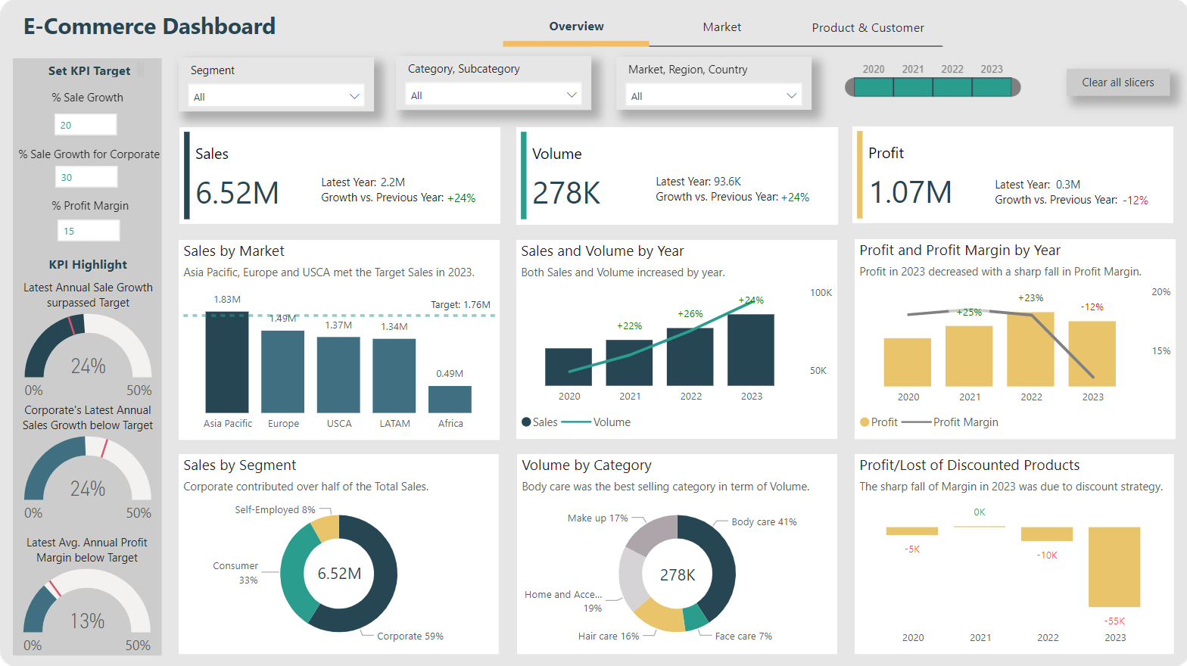
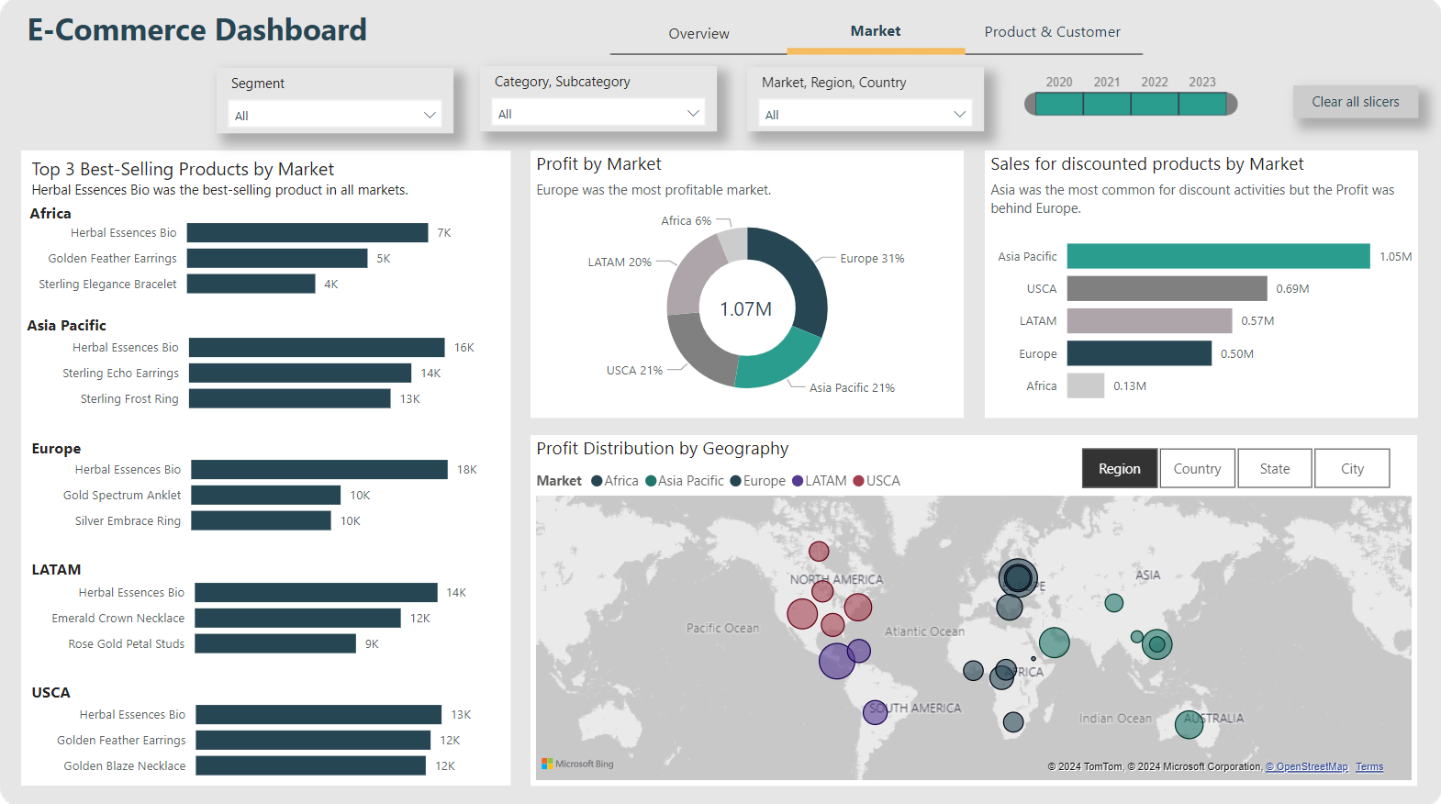
E-Commerce – FP20 Data Challenge
Link to Linkedin post by Thuong Huyen Pham

Slide 3
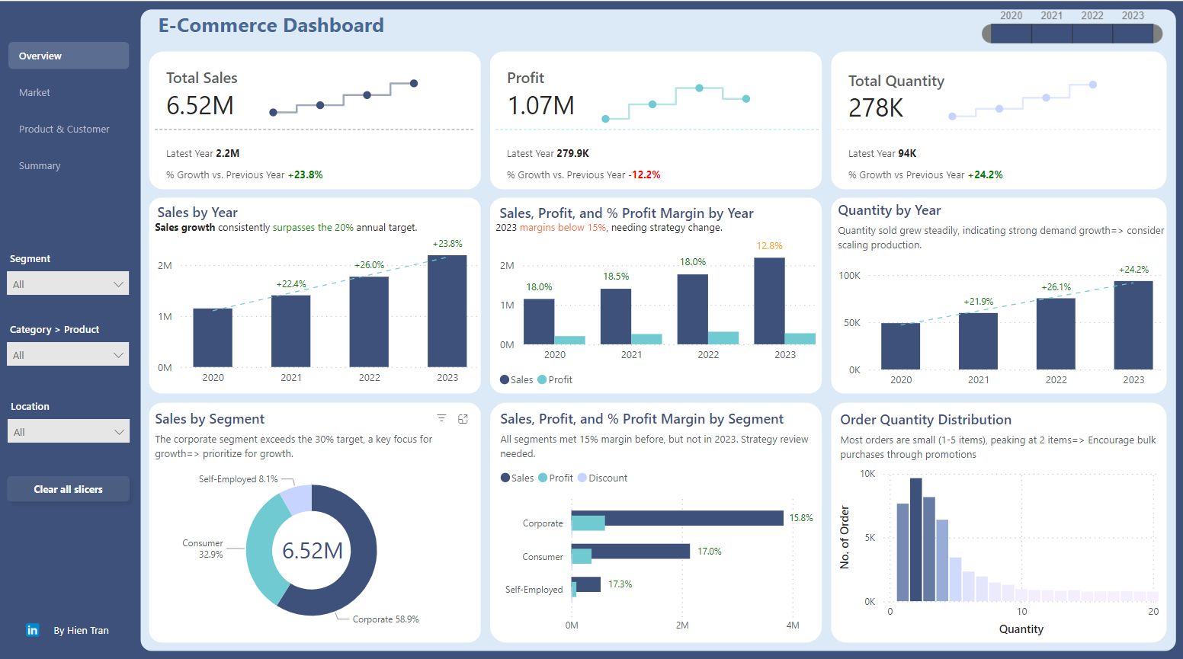
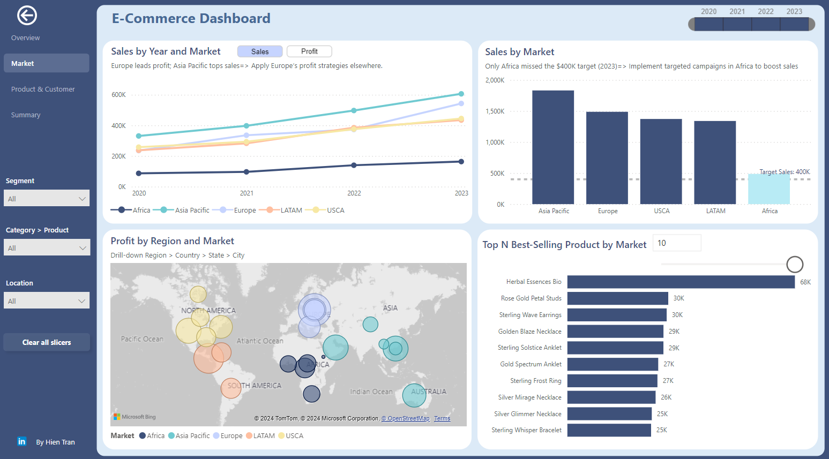
E-Commerce – FP20 Data Challenge
Link to Linkedin post by Hien Tran

Slide 4
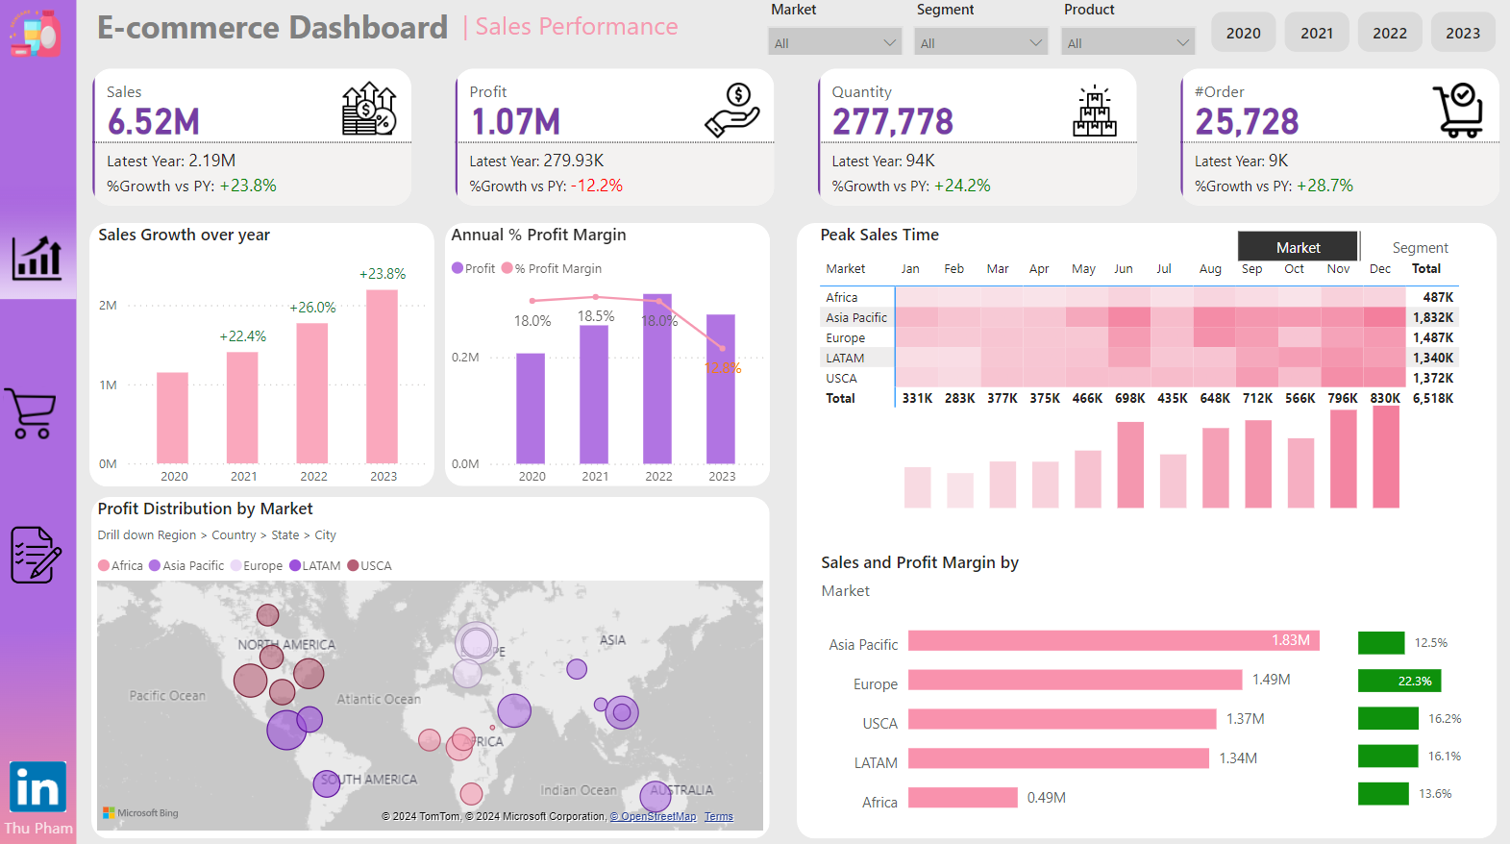
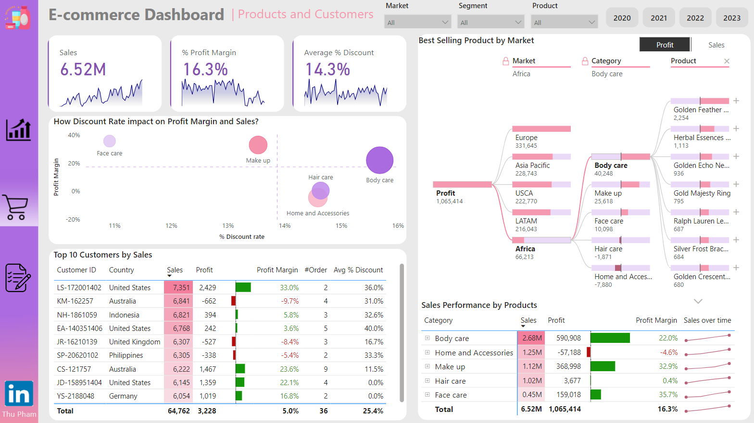
E-Commerce – FP20 Data Challenge
Link to Linkedin post by Jessie Thu Pham

Slide 5
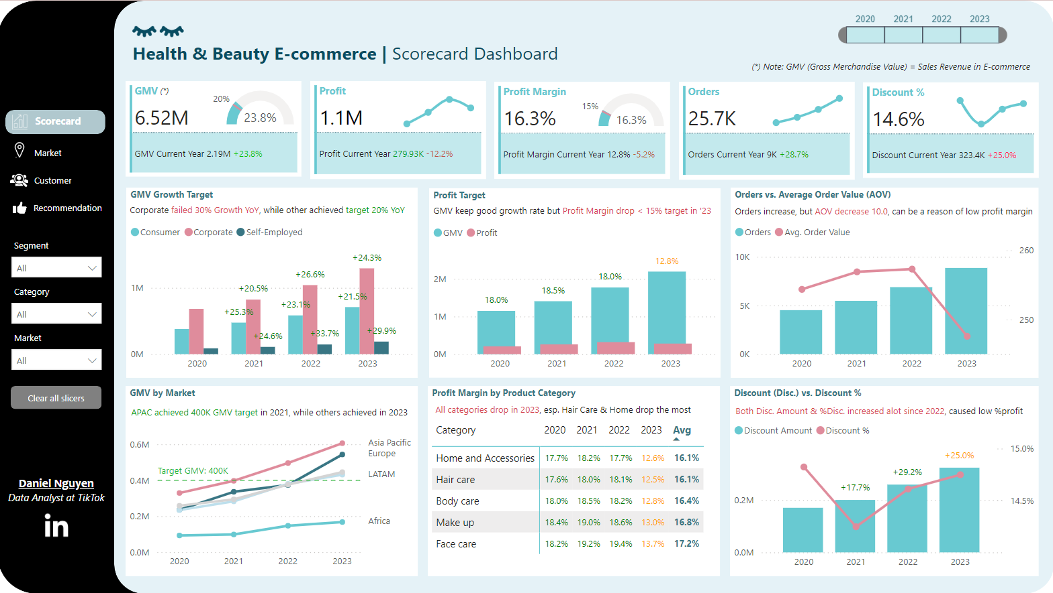
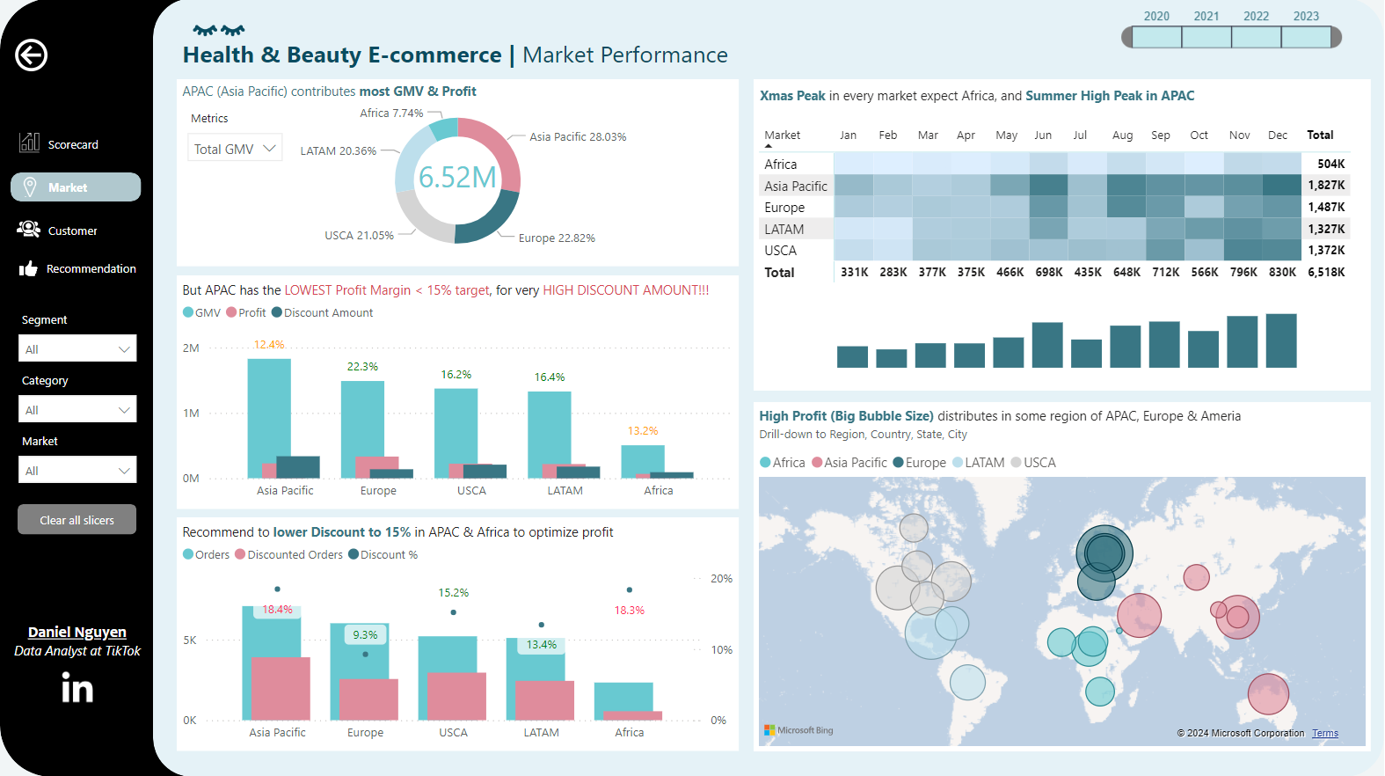
E-Commerce – FP20 Data Challenge
Link to Linkedin post by Son Hoang Nguyen

Slide 6
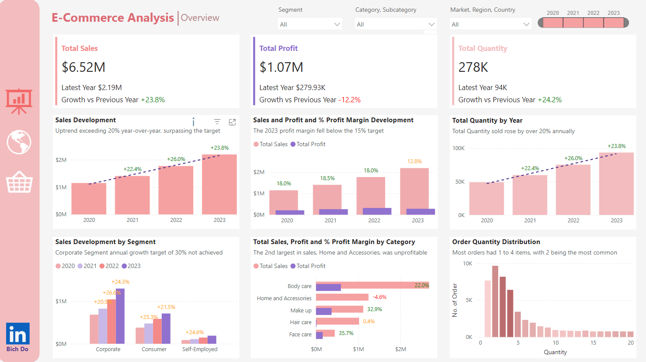
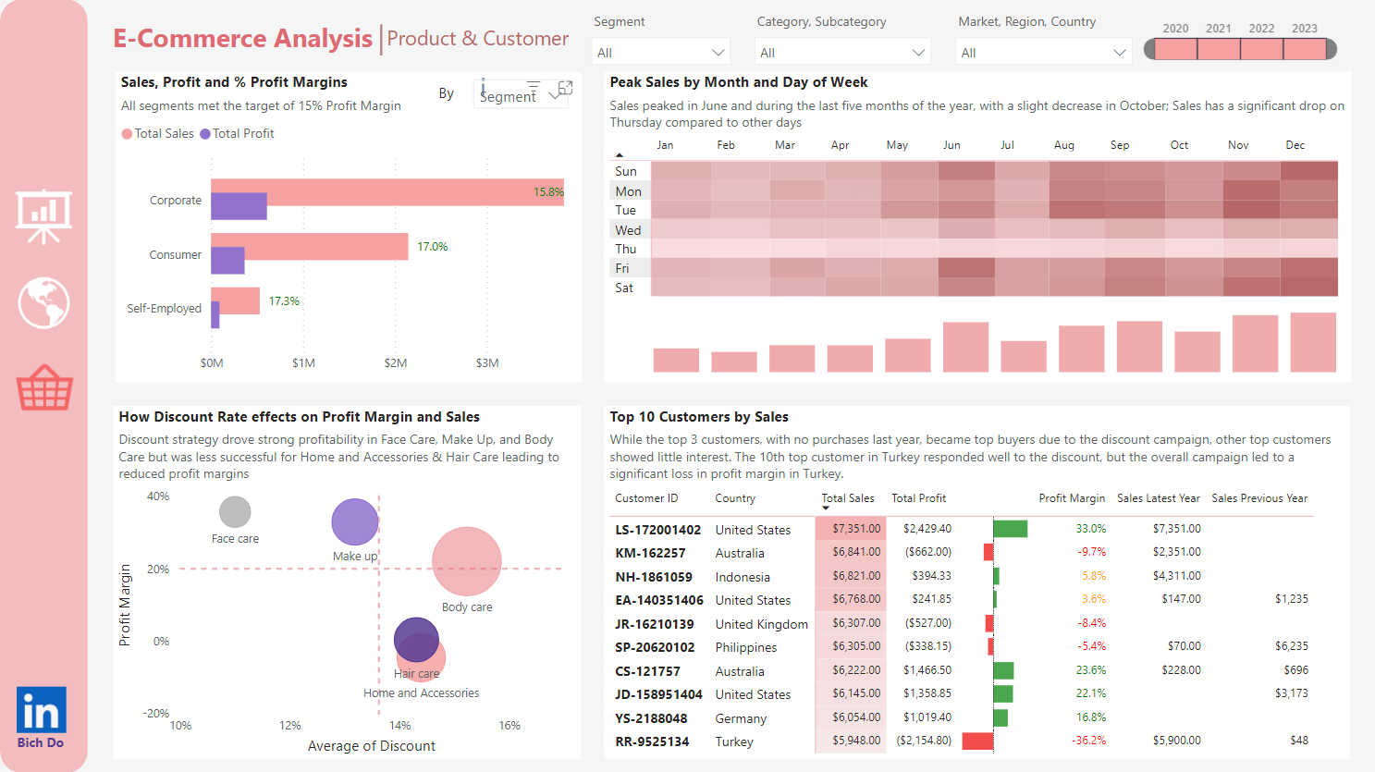
E-Commerce – FP20 Data Challenge
Link to Linkedin post by Bich Do

Slide 7
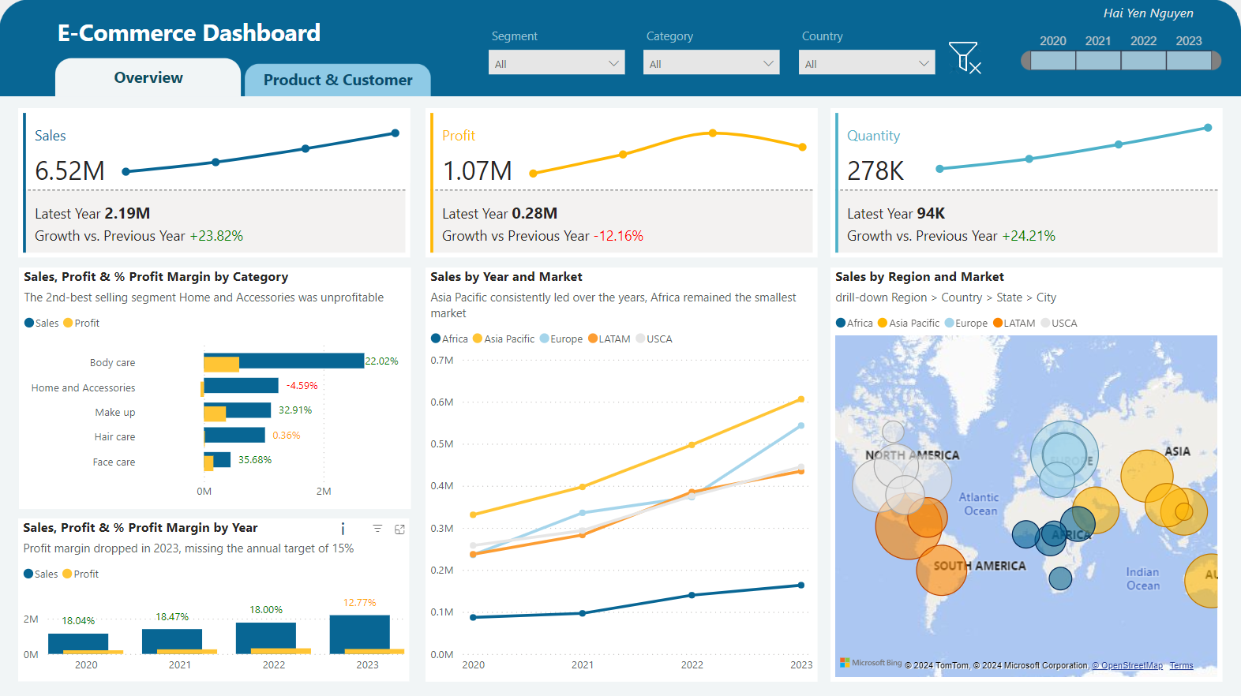
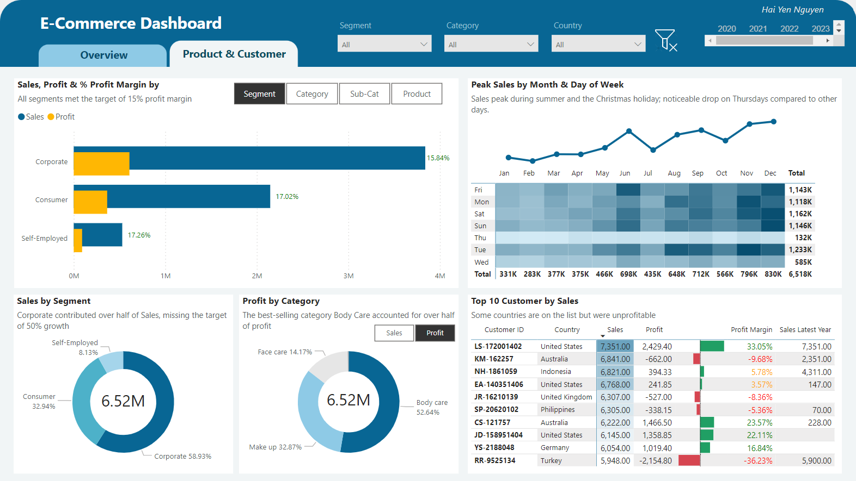
E-Commerce – FP20 Data Challenge
Link to Linkedin post by Hai Yen Nguyen

Slide 8
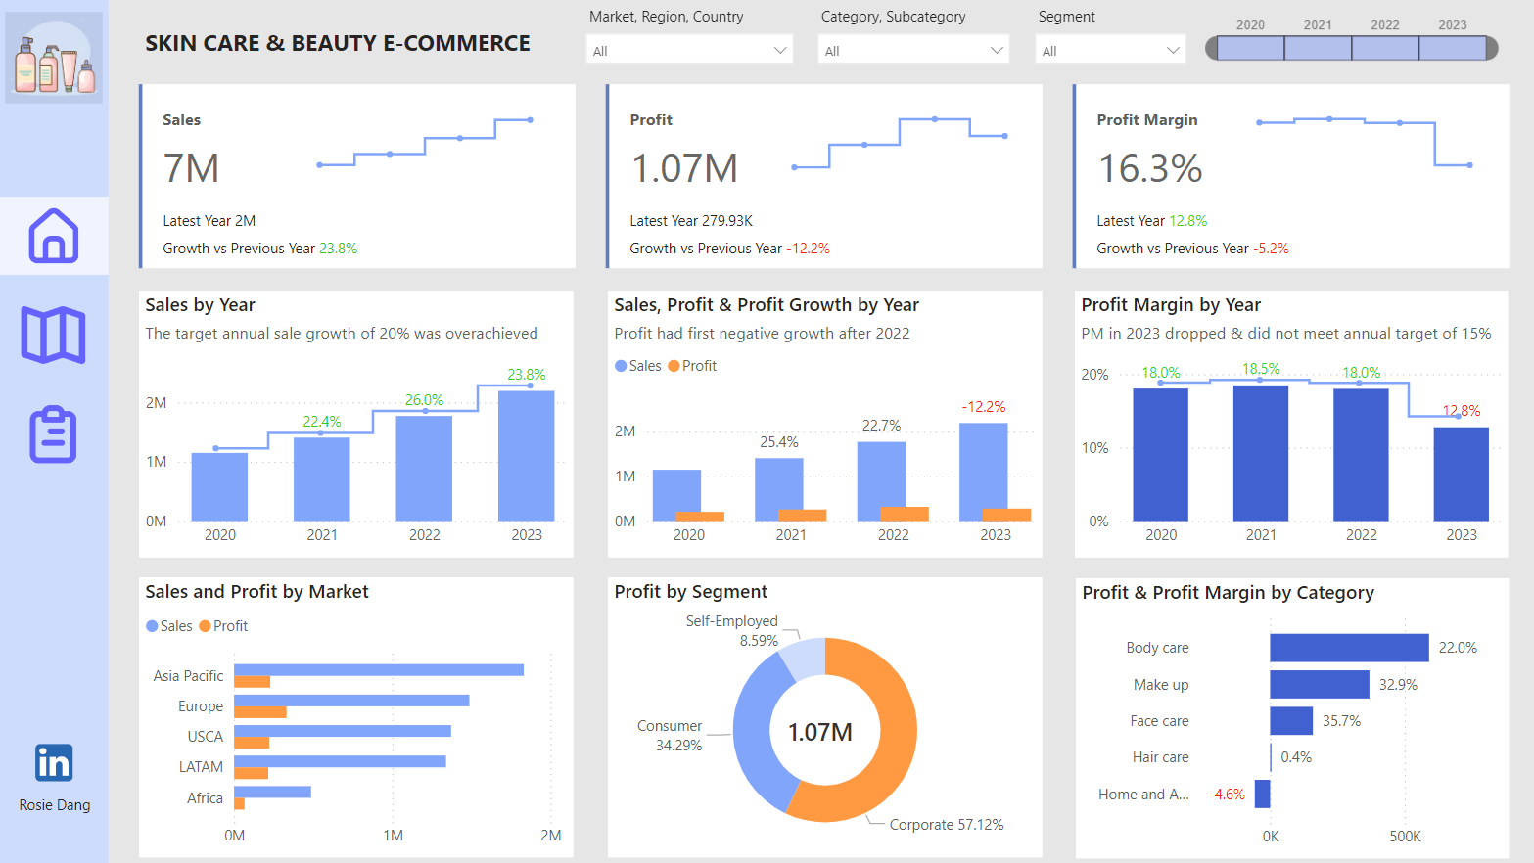
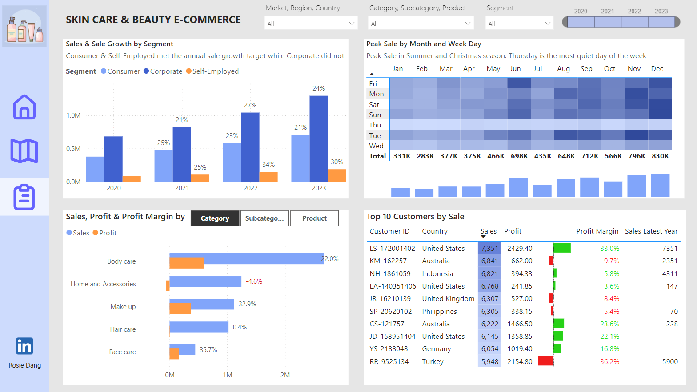
E-Commerce – FP20 Data Challenge
Link to Linkedin post by Rosie Dang

Slide 9
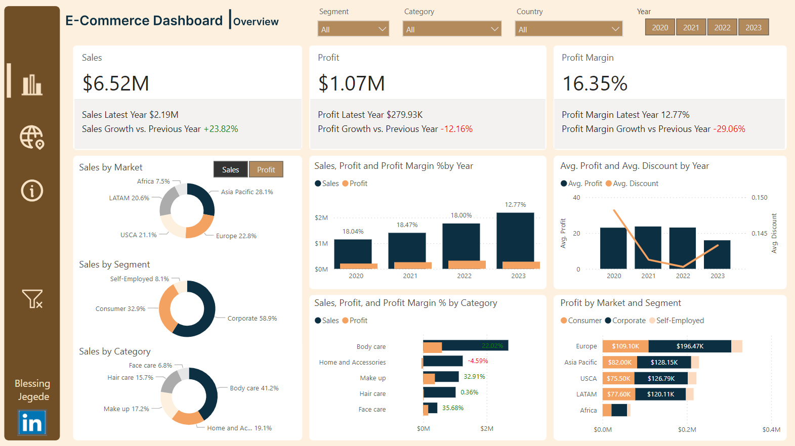
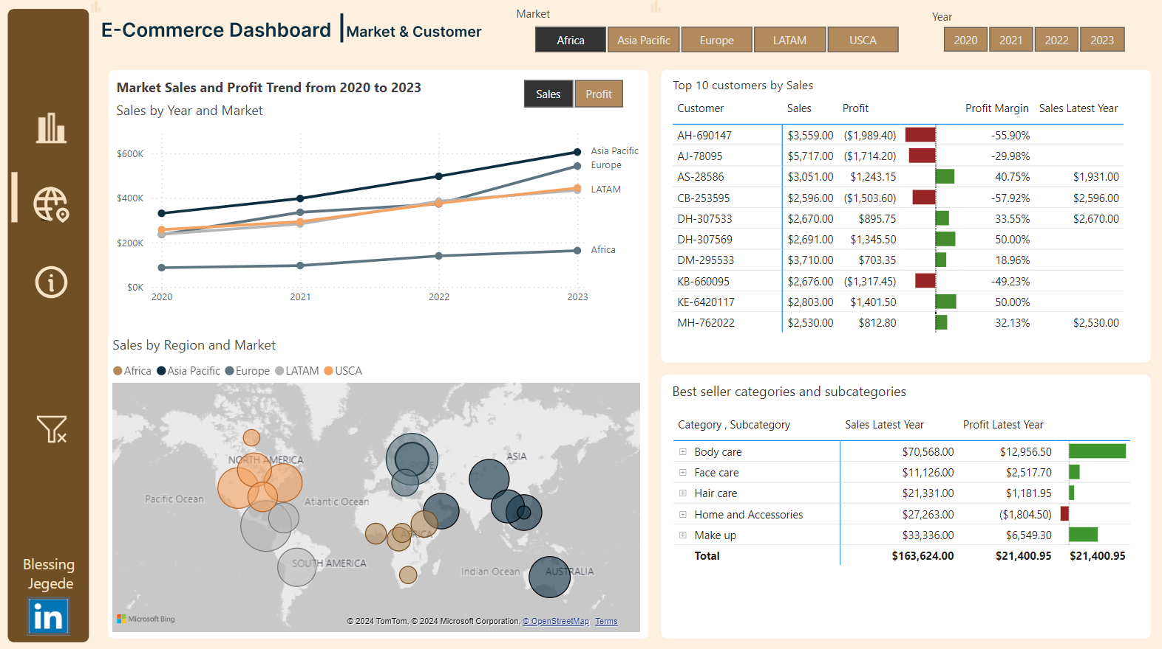
E-Commerce – FP20 Data Challenge
Link to Linkedin post by Blessing Jegede

Slide 10
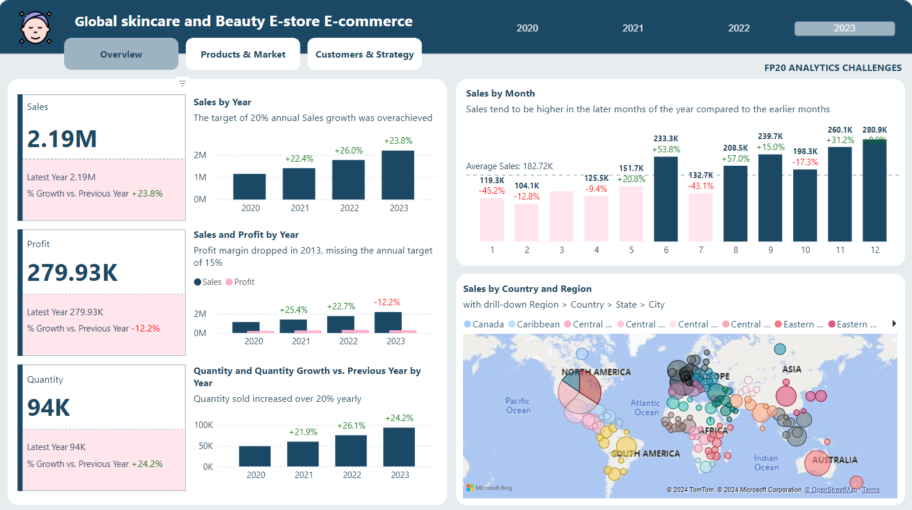
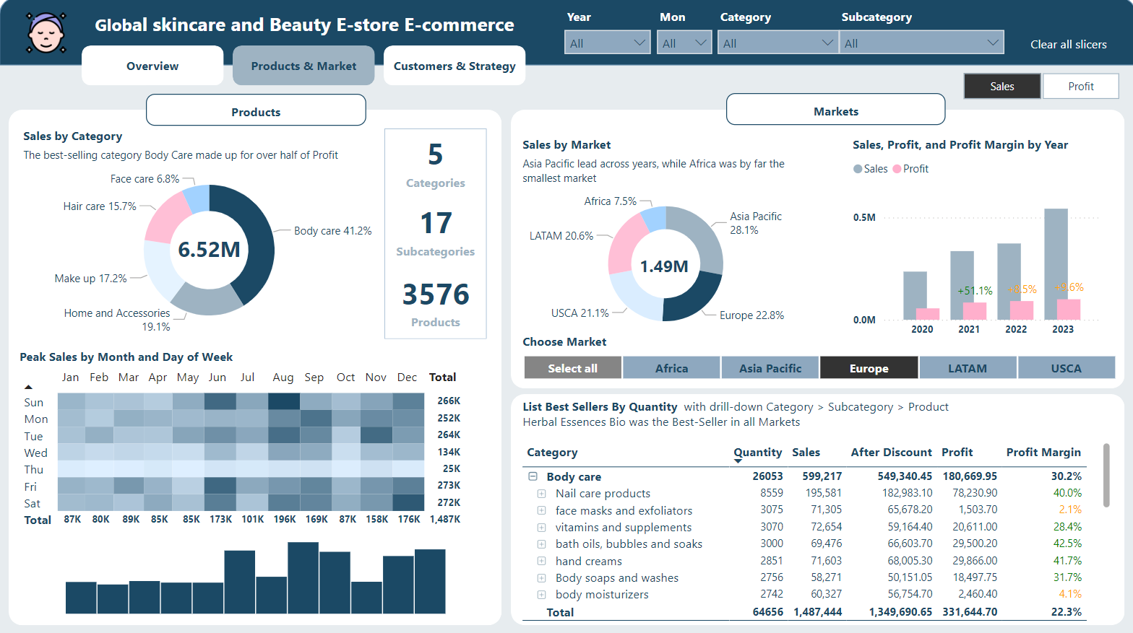
E-Commerce – FP20 Data Challenge
Link to Linkedin post by Nguyen Thuy Linh

Slide 11
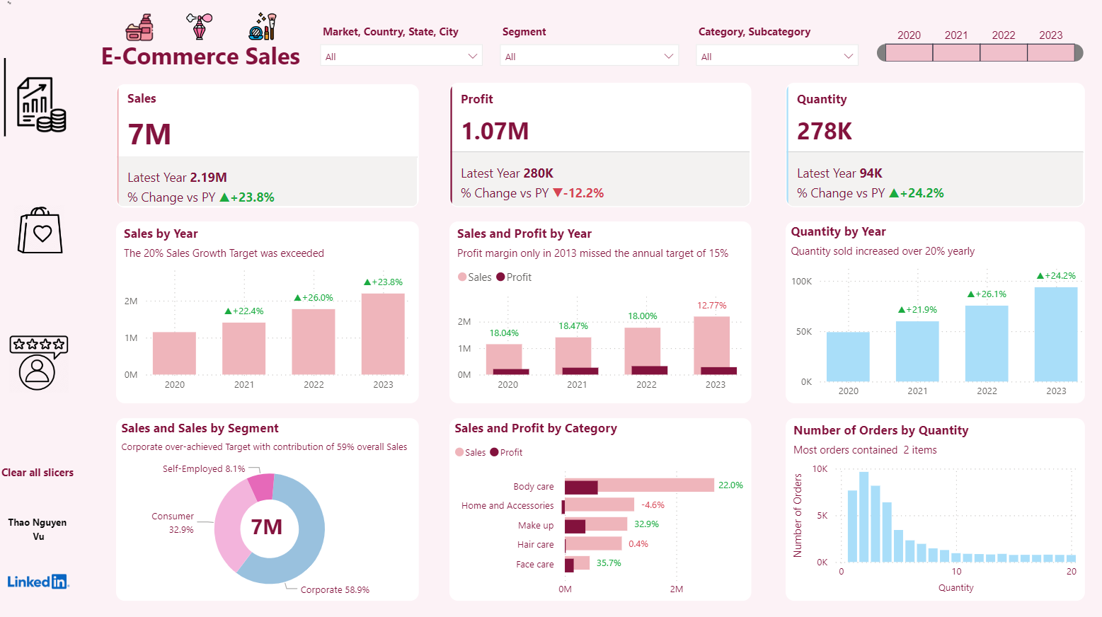
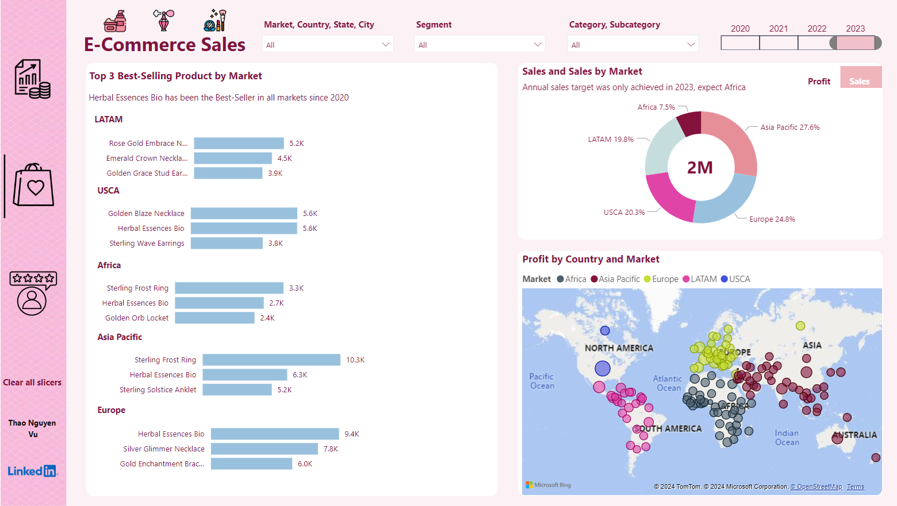
E-Commerce – FP20 Data Challenge
Link to Linkedin post by Thao Nguyen Vu

Slide 12
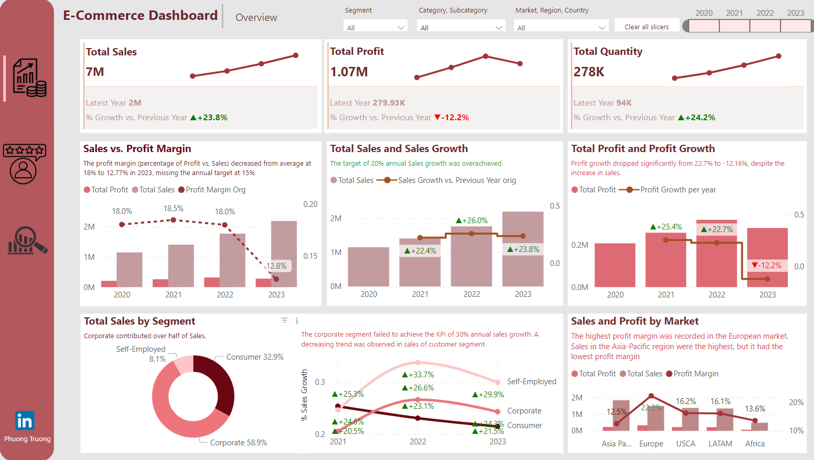
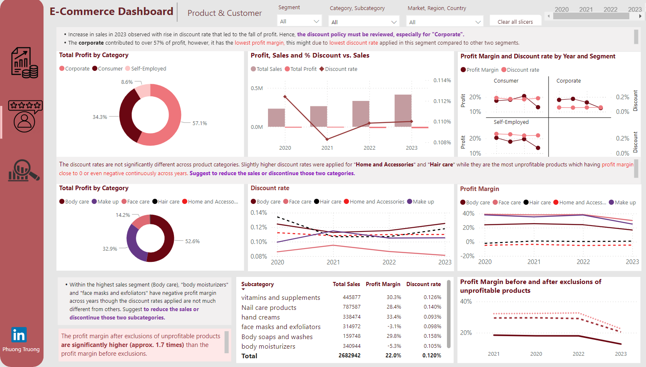
E-Commerce – FP20 Data Challenge
Link to Linkedin post by Truong Nguyen Thao Phuong

Slide 13
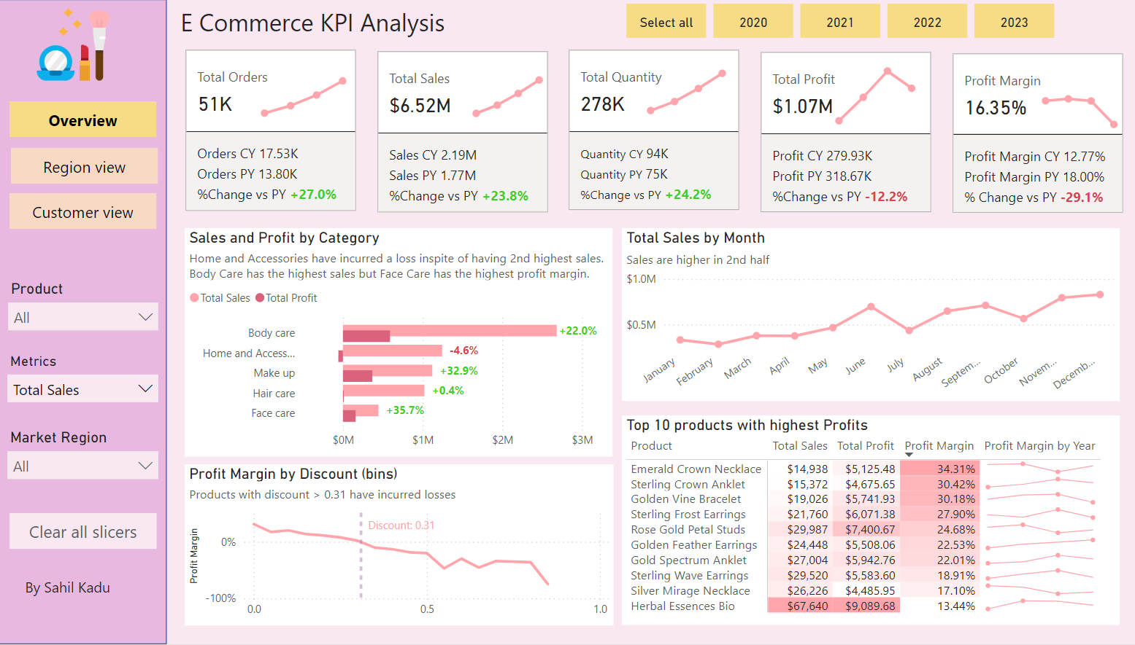
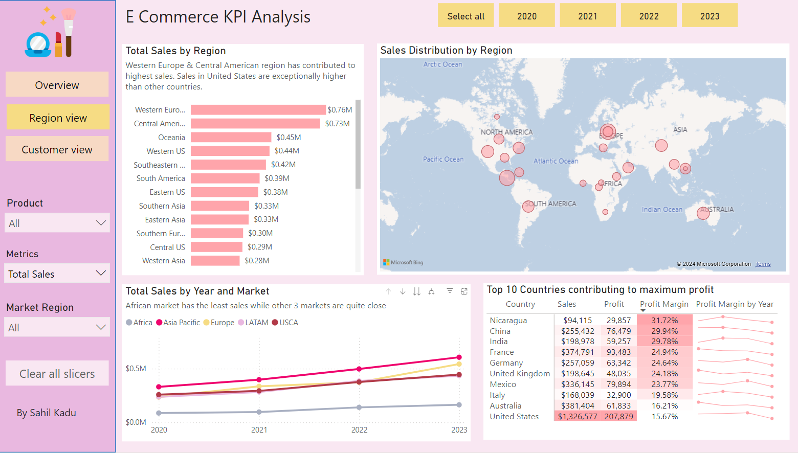
E-Commerce – FP20 Data Challenge
Link to Linkedin post by Sahil Kadu

Slide 14
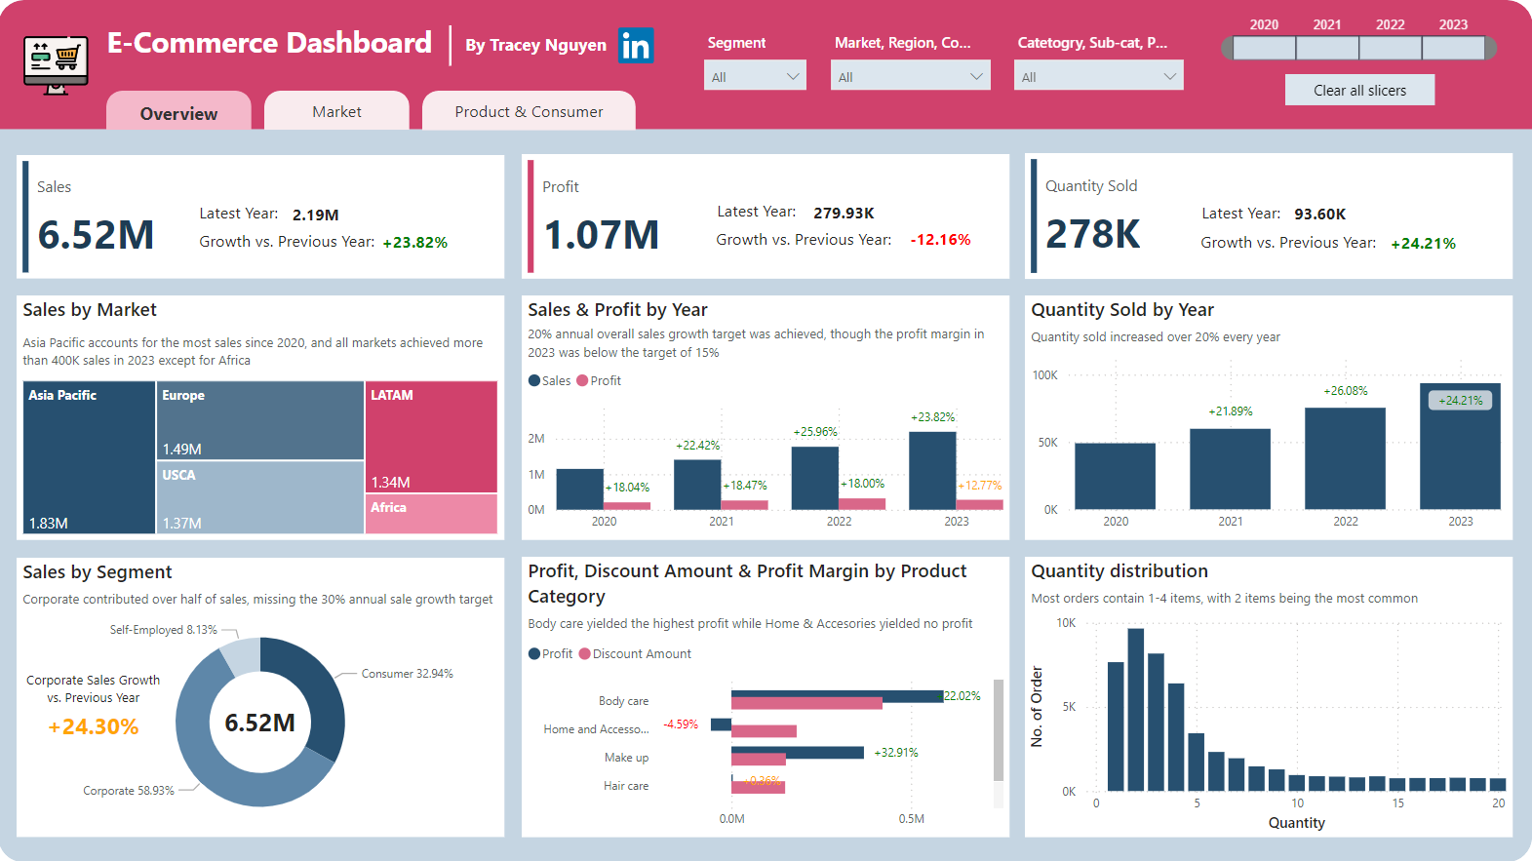
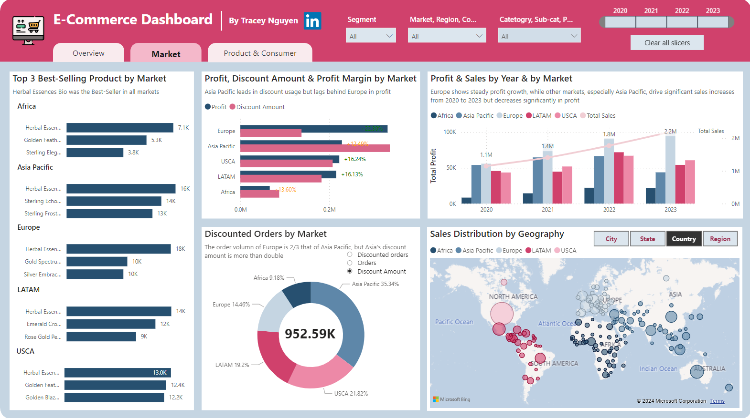
E-Commerce – FP20 Data Challenge
Link to Linkedin post by Tracey Nguyen

Slide 15
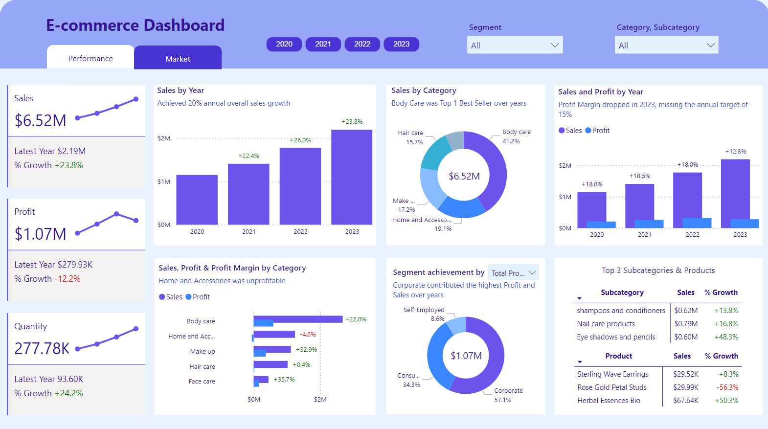
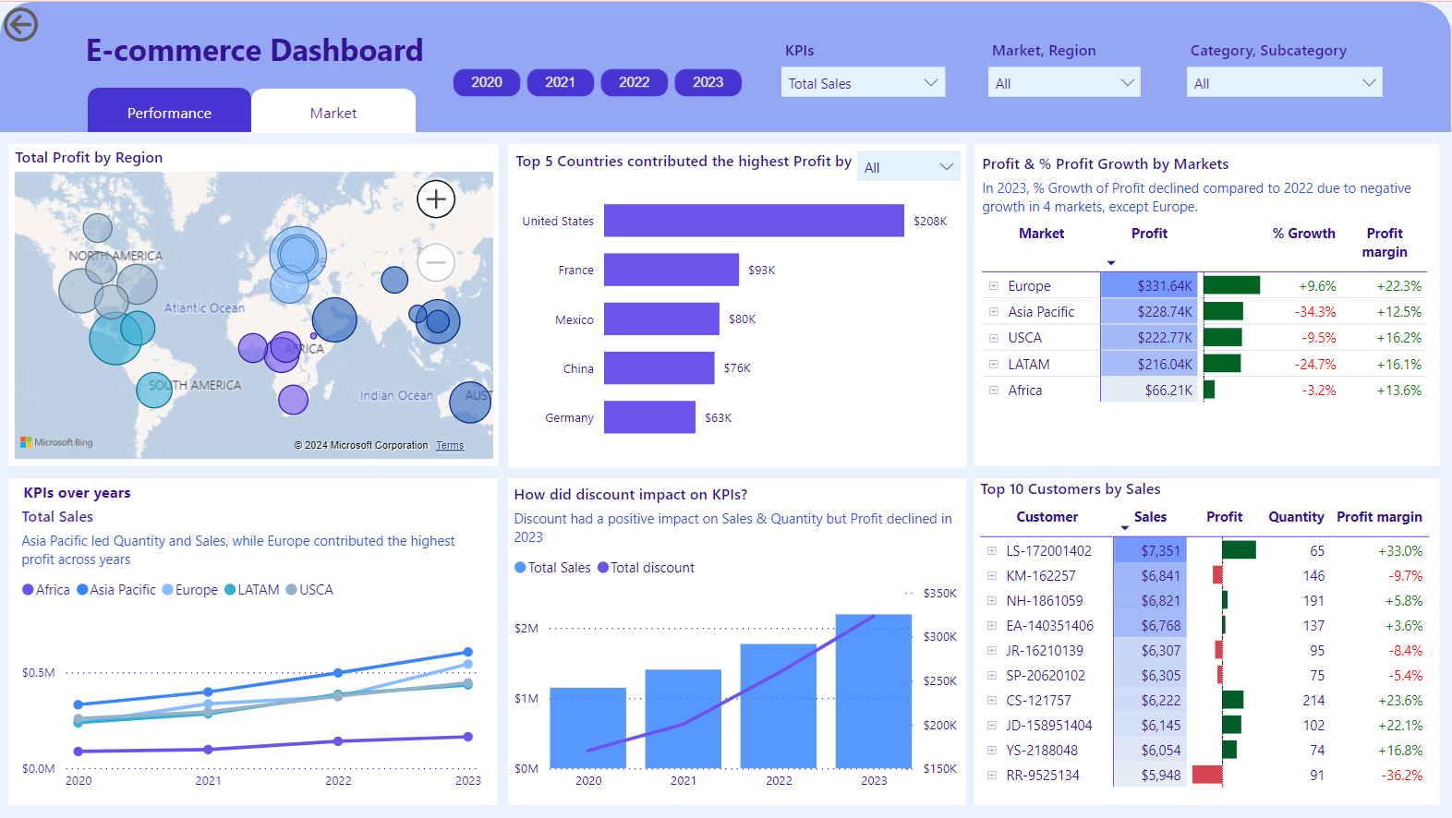
E-Commerce – FP20 Data Challenge
Link to Linkedin post by Nhi Lam

Slide 16
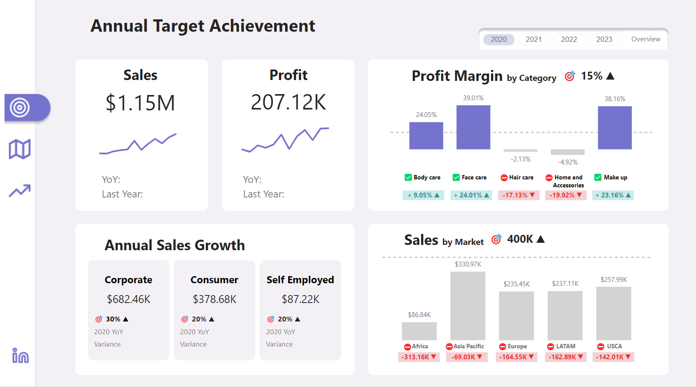
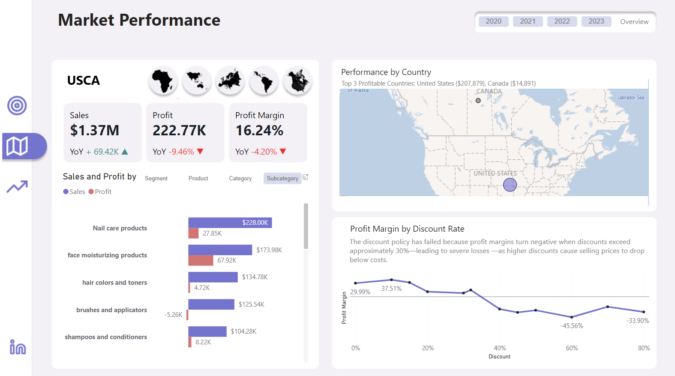
E-Commerce – FP20 Data Challenge
Link to Linkedin post by Sam Park

Slide 17
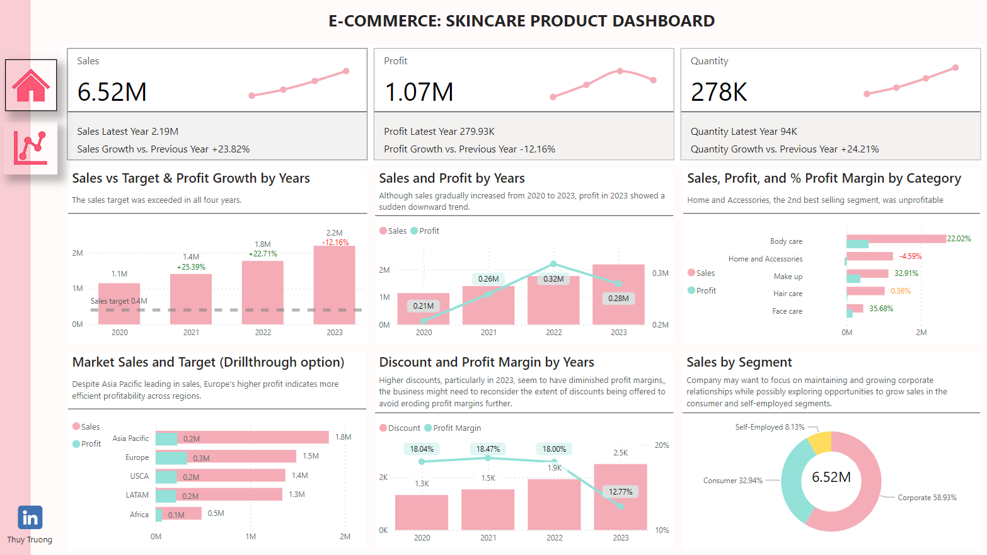
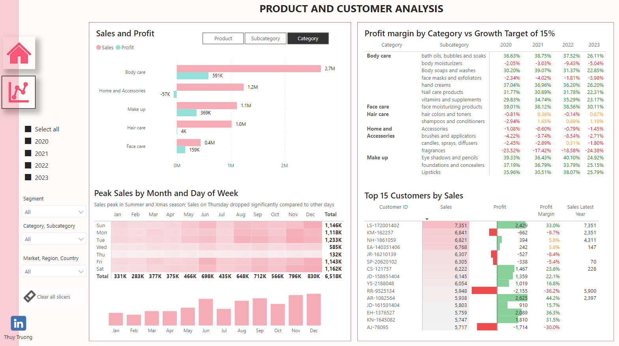
E-Commerce – FP20 Data Challenge
Link to Linkedin post by Thuy Truong

Slide 18
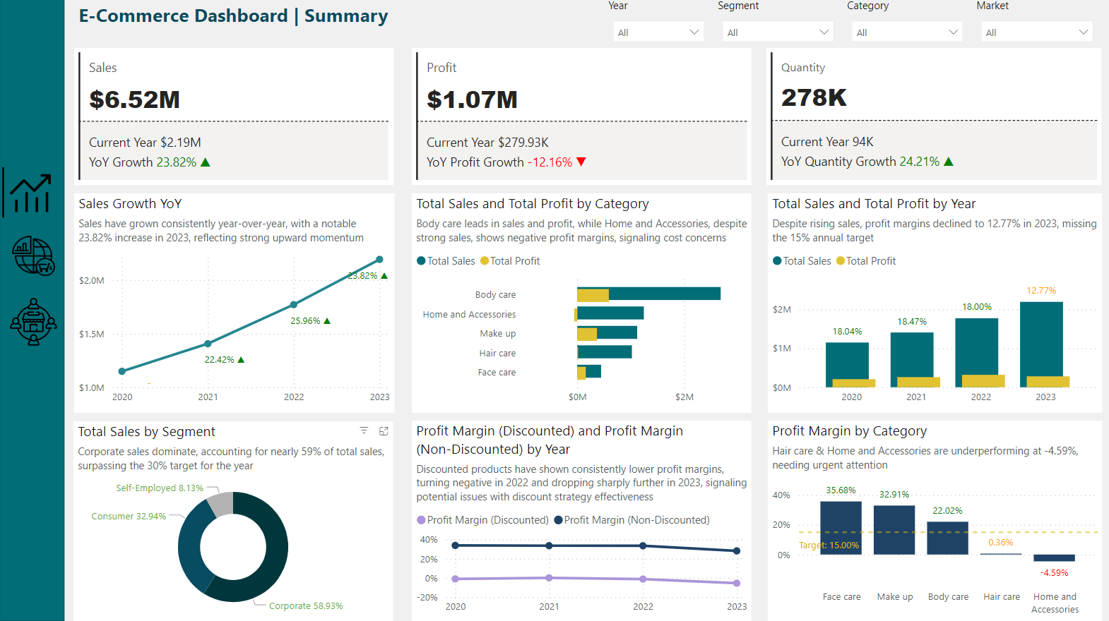
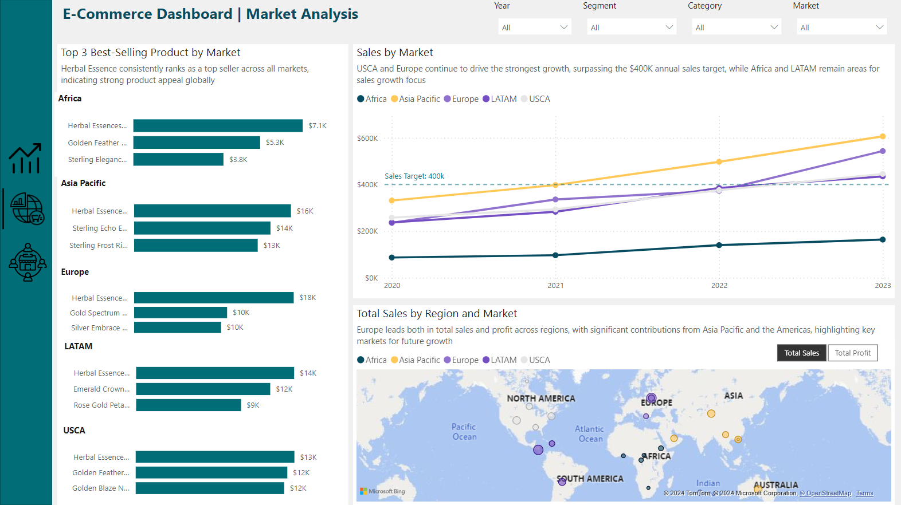
E-Commerce – FP20 Data Challenge
Link to Linkedin post by Nhu Tran

Slide 19
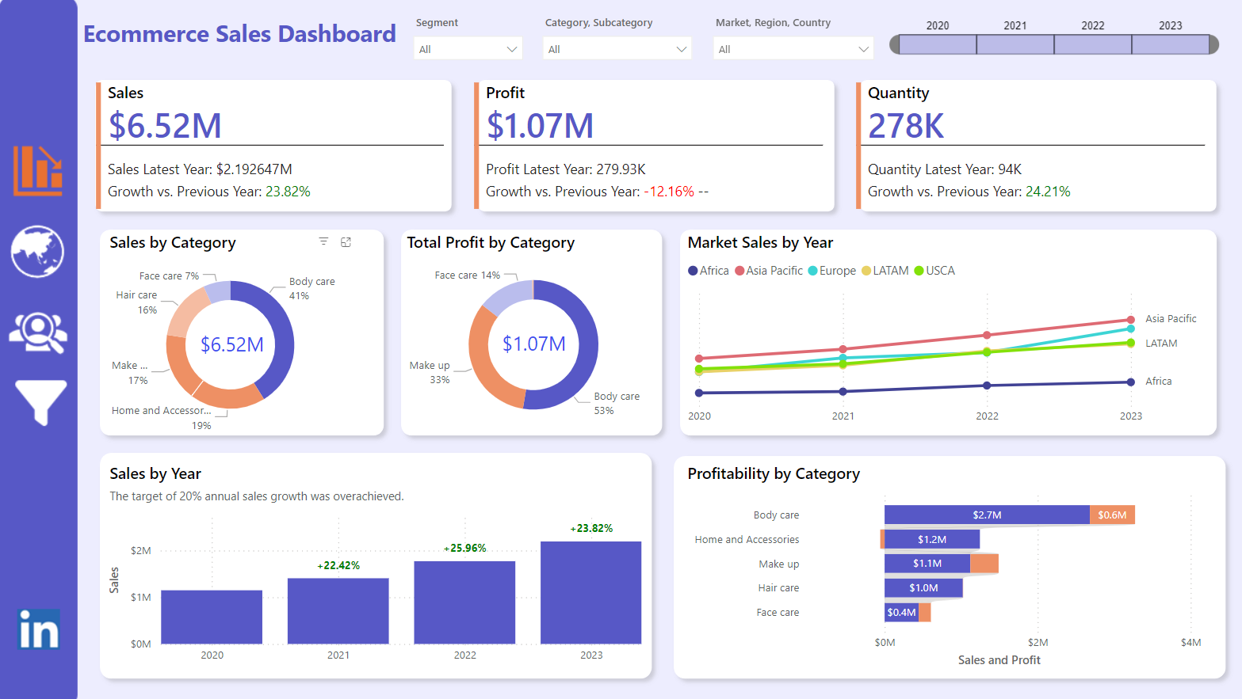
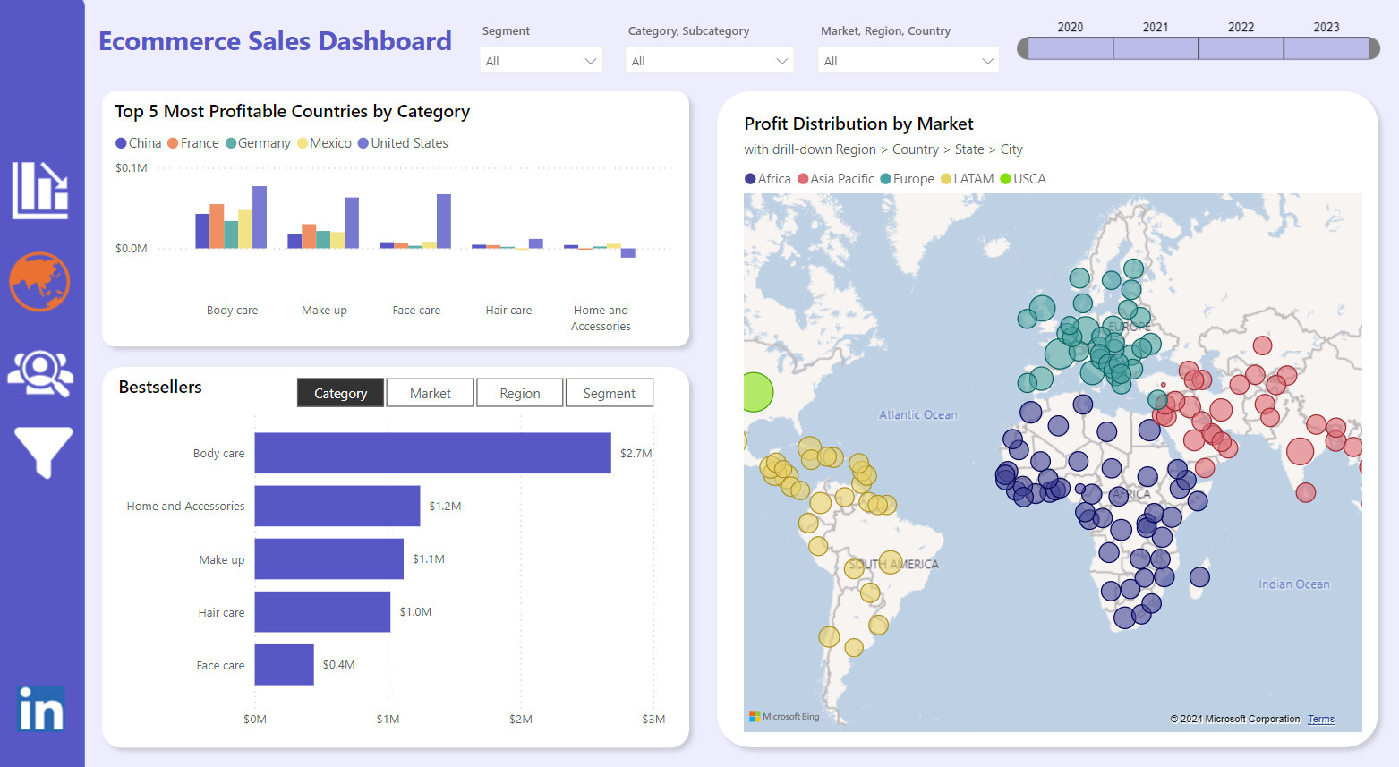
E-Commerce – FP20 Data Challenge
Link to Linkedin post by Malvika Mall

Slide 20
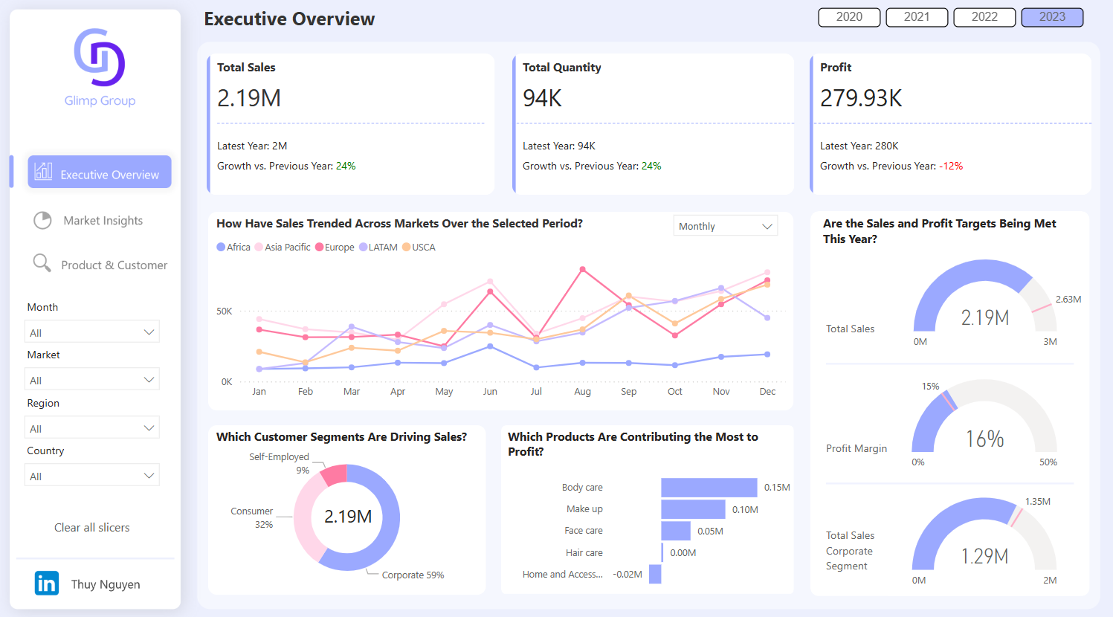
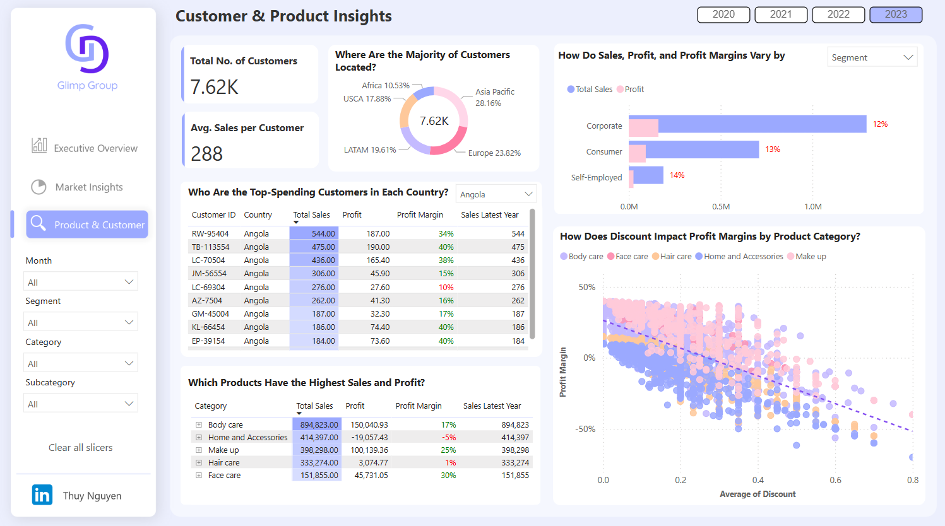
E-Commerce – FP20 Data Challenge
Link to Linkedin post by Thuy Nguyen

Slide 21
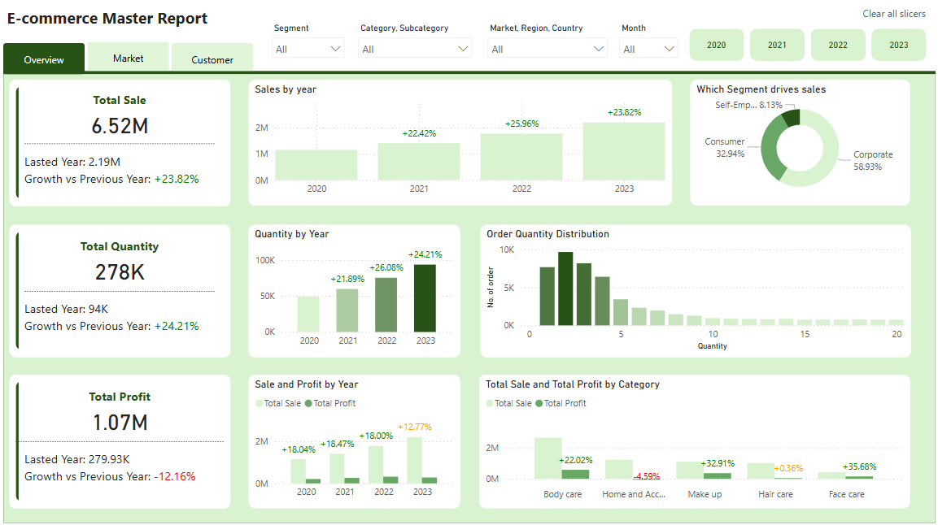
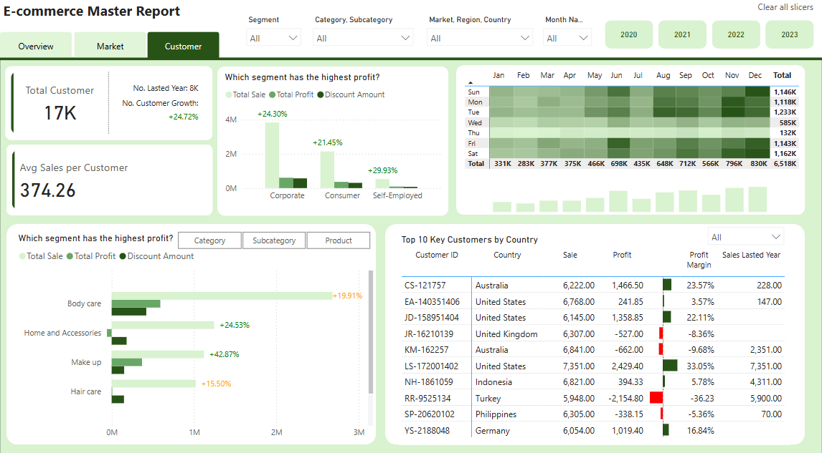
E-Commerce – FP20 Data Challenge
Created by Tuyet Tam Mai Nguyen

Slide 22
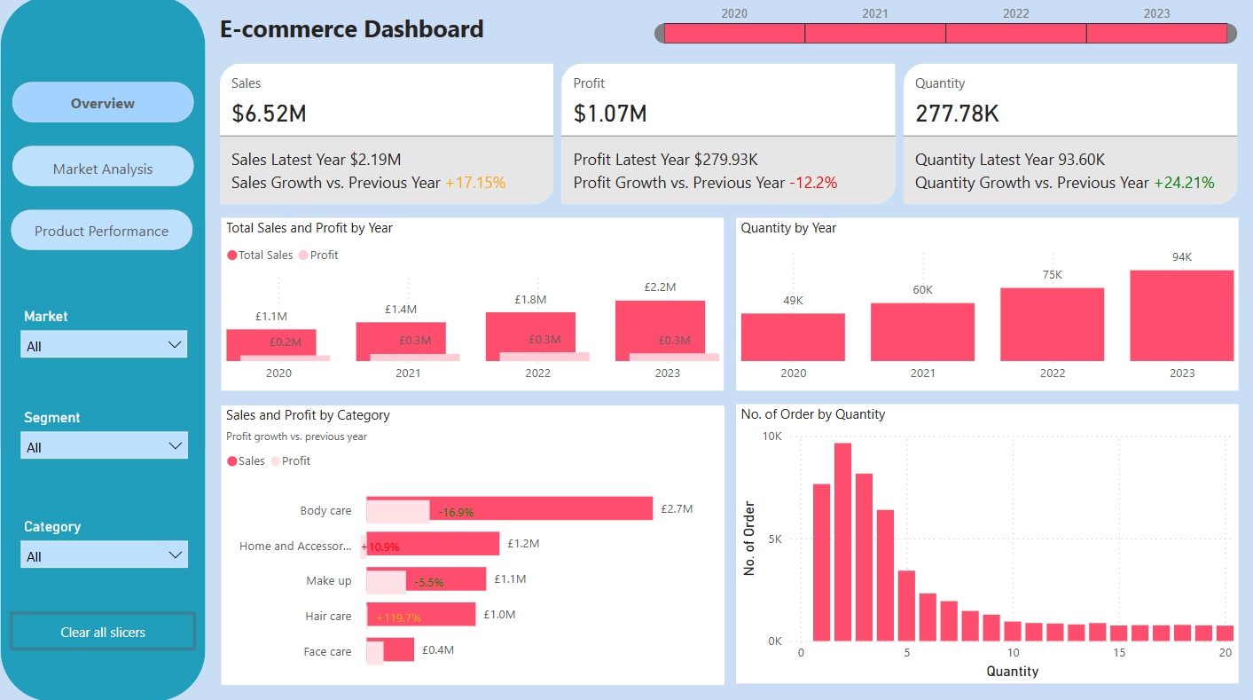
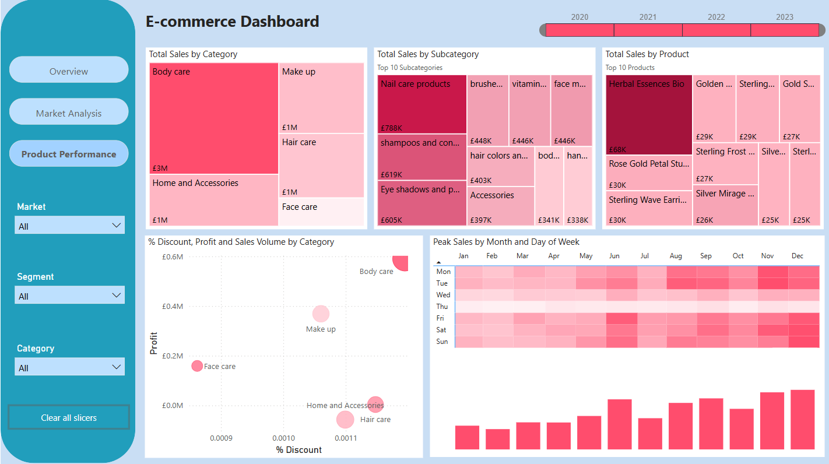
E-Commerce – FP20 Data Challenge
Link to Linkedin post by Fernanda Goularte

Slide 23
Thank you!
Anh Leimer
Any questions please contact me via:
Email: anh.leimer@gmail.com
Linkedin: Anh Leimer

